Slide 1
Basic Mesh Modeling
Sustainability
By Friend

Slide 2
Pre-workshop
For part 1, read and do stuff assigned in sections up to and including “Install and open Blender”
For part 2, do this questionnaire and put your results on Slack https://footprint.wwf.org.uk/#/
It’s a UK quiz, so try to match to you the best you can; for example:
Green tariff ≈ carbon tax
Use Google Maps to check your flight distance
I’m at 154% because I flew 4 times last year

Slide 3
Part 1: Basic Mesh Modeling

Slide 4
If there’s a word you don’t understand in the slide, let me know and I’ll add it here

Slide 5
Note
If it’s a keyboard shortcut, I’ll use [ ]
If it’s a mouse click, I’ll use “ ”

Slide 6
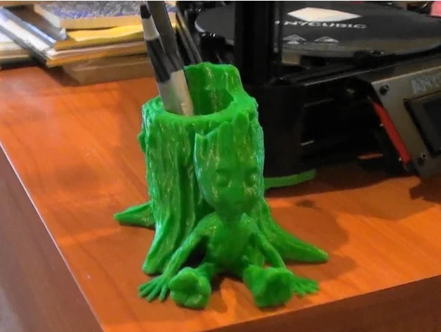
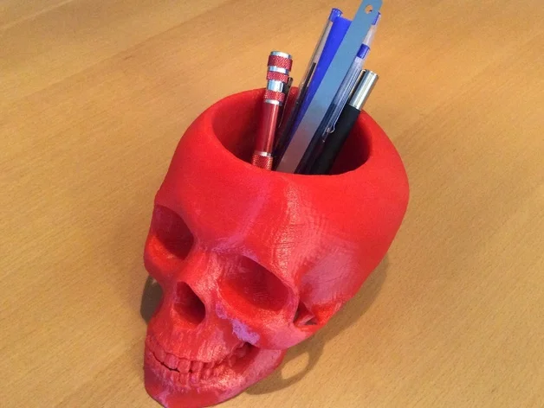
Agenda
We’ll walk through the process of making something similar to this pencil cup
https://www.thingiverse.com/thing:2143549
https://www.thingiverse.com/thing:933001
You’ll learn some Blender basics along the way
Enough to get you through 90% of 3D printing prototyping

Slide 7
Why Blender is better than Solidworks (sometimes)
#1: Save time (and money)
For most basic, first iteration prototypes, most likely someone’s already made something similar that you can adapt to your project
And they’ve put it up for free, online
Adapting it to your ideas is less time, compared to CAD something from zero
Popular 3d-print-able format for 3D models is STL (mesh, not CAD files, unfortunately), so Blender is better suited than Solidworks
#2: You can do everything Meshmixer does with Blender, and more
Some examples:
Closing hole: https://blender.stackexchange.com/questions/52661/how-can-i-close-a-big-hole-in-a-mesh
Plane cut: https://blender.stackexchange.com/questions/88578/how-do-i-bisect-along-an-axis
Much larger user community than Meshmixer
Someone’s already answered any question to anything you need to fix in Blender
Many useful Blender plugins people write and put up for free
You can do animation, video editing, modeling, etc. (and even CAD if you want to)

Slide 8
Find models
The main elements of this project are:
A model
A hole
A bottom plate if the hole cuts through the model, or model doesn’t stand on itself
We can make the hole and the bottom plate in Blender, so for now, find a nice model on thingiverse.com you want to put a hole through
Good if it’s solid block that stands on its own
Ideas: dogs, cats, skull, moon, globe, turtle, bunny, R2D2, mushroom cloud

Slide 9
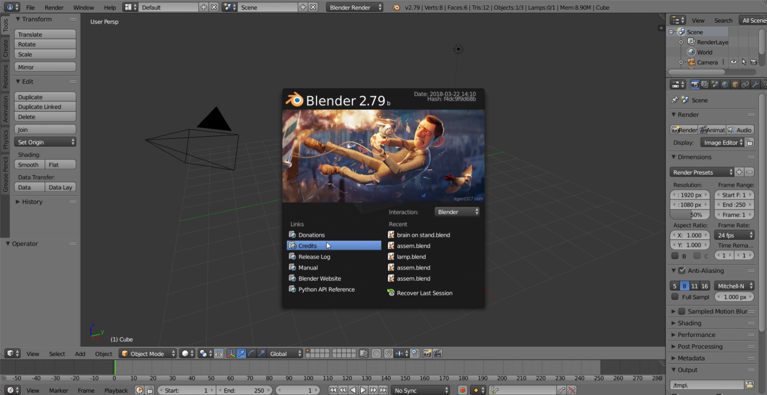
Install and open Blender
Go to blender.org, download, and install
It’s a fairly clean website unlike Lulzbot’s so I won’t go into detail
I’ll use Blender 2.79 in this workshop
Blender 2.80’s new UI is easier to use, but there isn’t as much resources on it online yet, so I’ll stick with Blender 2.79
Open it once you’re done, click anywhere outside the center to make the middle pop up go away

Slide 10
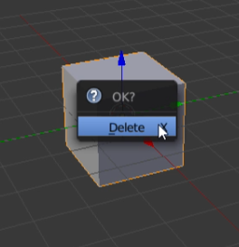
Install and open Blender
Get rid of the default cube by pressing [X] and click “Delete”

Slide 11
Manipulate your view
To rotate view, hold middle mouse button, and drag your mouse
To move view, hold [Shift] and middle mouse button, and drag your mouse

Slide 12
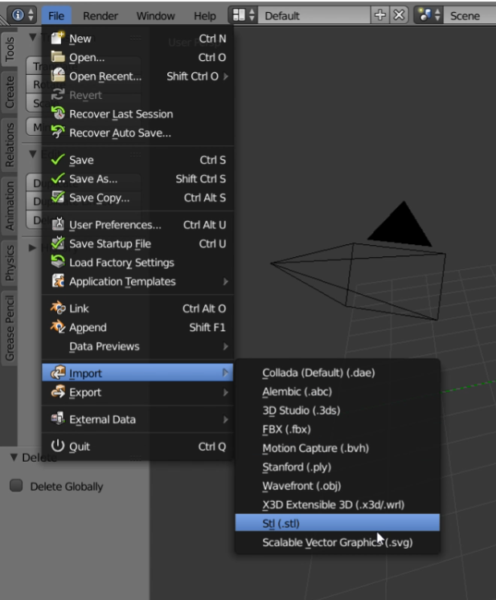
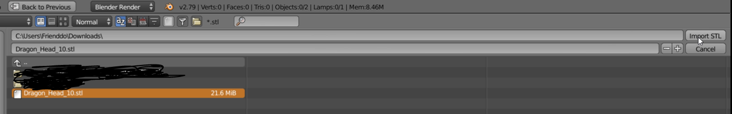
Import and center your model
To import, click “File” (top left corner) -> “Import” -> “Stl (.stl)”
Go to the folder, click on the file, then click “Import STL”
I picked this https://www.thingiverse.com/thing:478774

Slide 13
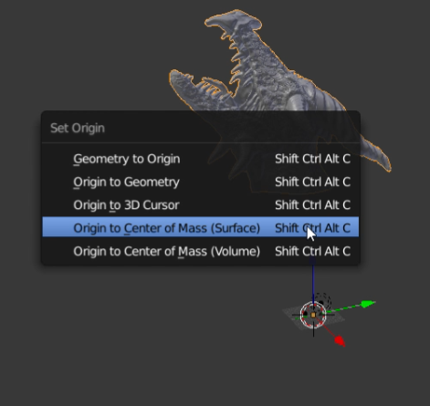
Import and center your model
STL are sometimes not centered to origin
If you don’t see it, use the middle mouse scroll, and zoom out until you see it
Press [Shift]+[Ctrl]+[Alt]+[C], then click “Origin to Center of Mass (Surface)”
You can use Volume as well; they’re approximately the same

Slide 14
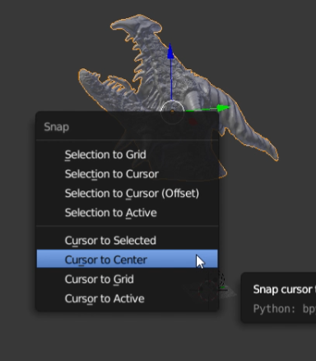
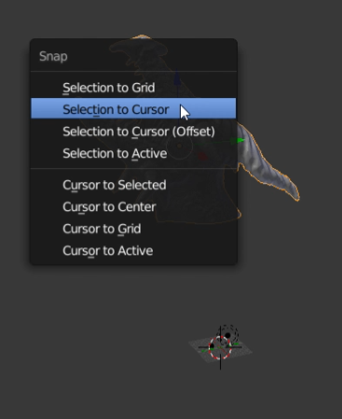
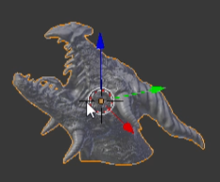
Import and center your model
Press [Shift]+[S], click “Cursor to Center”
Click “Selection to Cursor”
Your model should snap to center of the world now

Slide 15
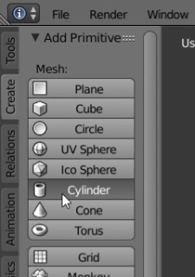
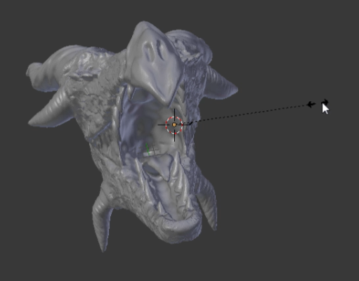
Make a hole
Click “Create” -> “Cylinder”
We’ll use this model to as the hole
You can make a square, or a cone hole too if you want
Before you click anything else, press [S] and drag your mouse outwards
This will scale up your cylinder

Slide 16
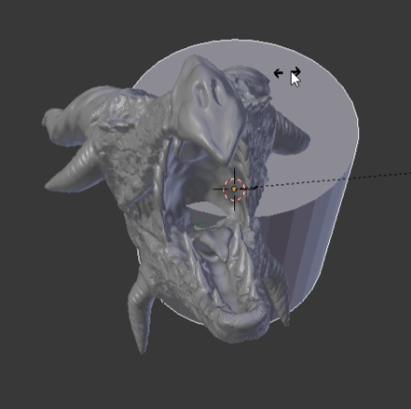
Make a hole
Once it’s to a scale that you can see, stop
To move the model, click [G]+[x/y/z]
To move along the local axis, rather than global axis, click [G]+[x/y/z]+[x/y/z]
To rotate the model, click [R]+[x/y/z]
To rotate along the local axis, rather than global axis, click [R]+[x/y/z]+[x/y/z]
To scale the model, click [S]+[x/y/z]
To scale along the local axis, rather than global axis, click [S]+[x/y/z]+[x/y/z]

Slide 17
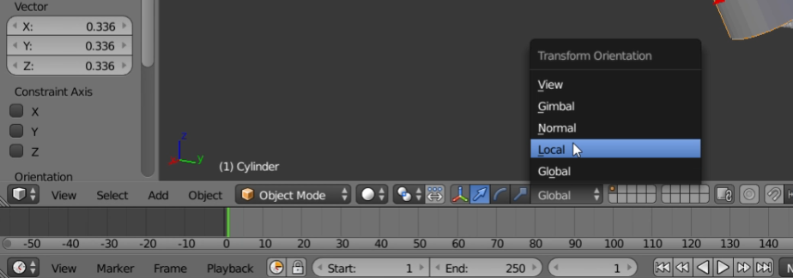
Make a hole
It might be hard to visualize rotating or scaling along local axis without seeing local axis, so you can change that on the bottom toolbar

Slide 18
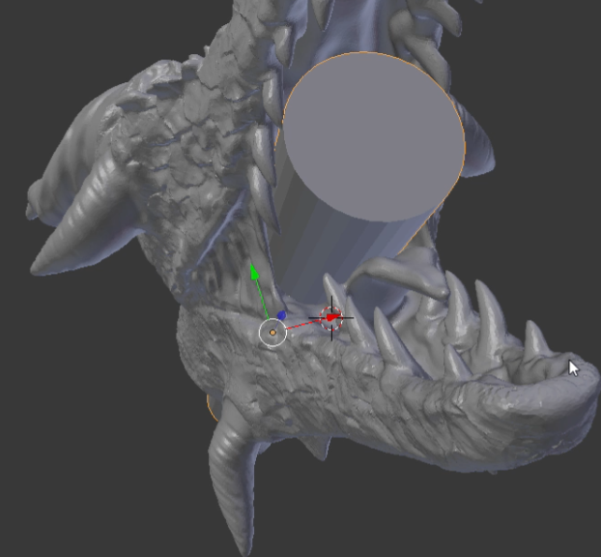
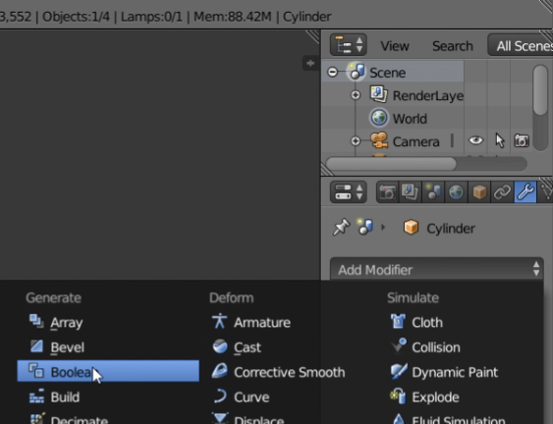
Make a hole
Once you have put it in the right position, go to the right toolbar, click on the wrench icon -> “Add Modifier” -> “Boolean”
THE IMAGE IS WRONG! You should select the main object, not the cylinder when applying boolean
You want to cut the hole in the dragon, not cut a dragon-shape hole in the cylinder

Slide 19
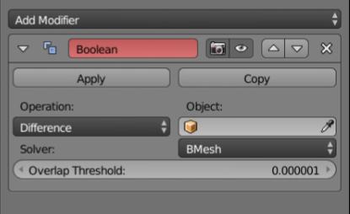
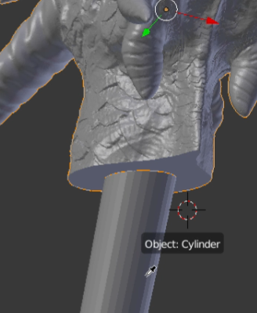
Make a hole
Change Operation to “Difference” (it’s a drop down menu)
Use the eyedrop icon near Object to select your cylinder

Slide 20
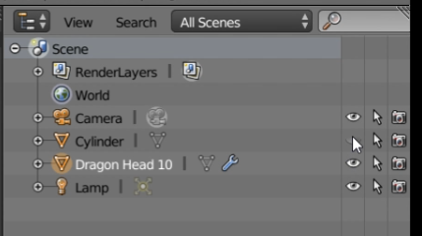
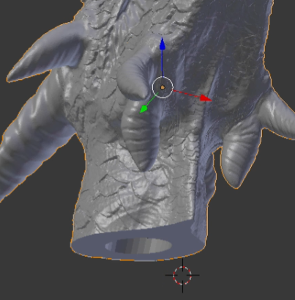
Make a hole
Click on the eye icon next to the cylinder’s name to not see it
You should be able to see the hole you’ve made very clearly

Slide 21
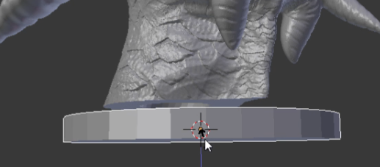
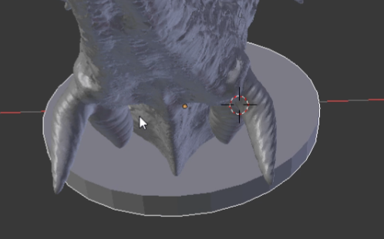
Make a base
Use the skills you learned when moving, rotating, and scaling a model to make the base
Make another cylinder and manipulate it into a base
Make sure the main model (ex: dragon) overlaps a bit with the base so it can become a single solid model

Slide 22
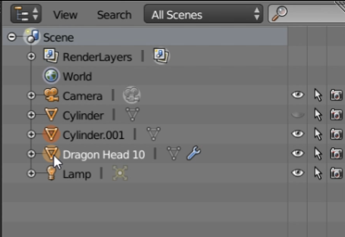
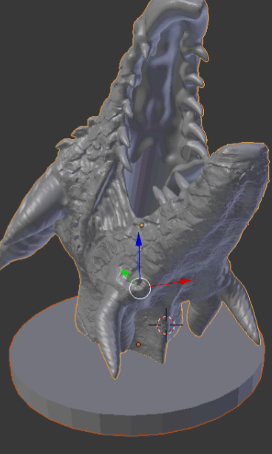
Exporting
Select only the model you want to export (hold [Shift] to select multiple things at once)
If you haven’t noticed by now, a model that is selected has an orange highlight around it

Slide 23
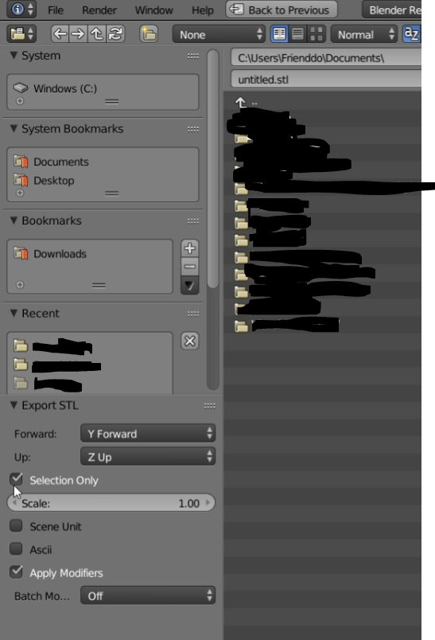
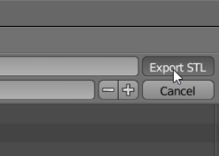
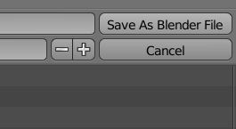
Exporting
Tick yes on “Selection Only” and “Apply Modifiers”
This will make sure only the stuff we’ve selected is exported (so the hole model doesn’t get exported), and the hole is actually cut into the main model
Save it anywhere you’d like by clicking “Export STL”
Save the whole Blender project by pressing [Ctrl]+[S], find a good directory, then click “Save As Blender File”
It’ll say “Save As” the first time you save

Slide 24
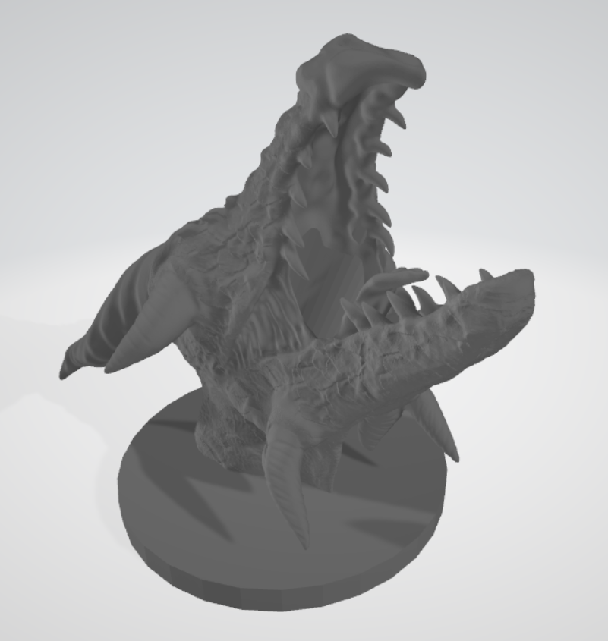
Final product
Nice
You can open it with 3D viewer (Windows) or Preview (Mac)
Import it to Cura to print

Slide 25
Other useful/cool stuff I didn’t mention
In edit mode, [Alt]+[S] to shrink/fatten
Good for clearances
In object mode, there’s Decimate as one of the boolean operations
Use to make low-poly toys

Slide 26
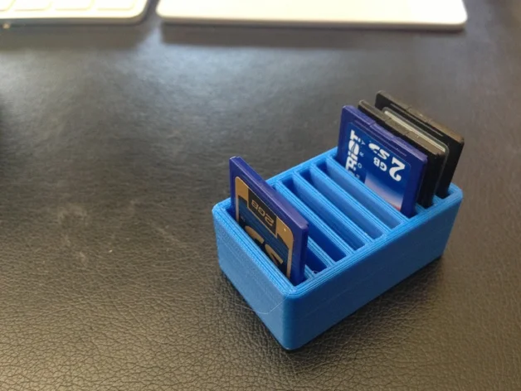
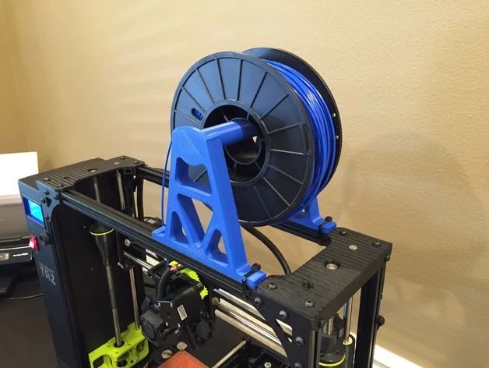
An example of what I’ve made using this method: SD card holder attached to 3D printer
SD card holder with boolean difference to cut it to have only one SD card slot
https://www.thingiverse.com/thing:56074
Spool holder with boolean difference to cut out for only the section to slot into aluminum extrusion
https://www.thingiverse.com/thing:1608830
Export them together

Slide 27
Some further readings
Modeling organic shapes https://blender.stackexchange.com/questions/45925/whats-the-best-way-to-model-organic-shapes
Physics simulation https://github.com/jonbruner/blender/tree/master/Cloth

Slide 28
Part 2: Sustainability

Slide 29
Note
This is going to be a straight-up lecture
I don’t like lecturing either (notice that most of the previous workshops are activities where you do, and I moderate)
But this is extremely important, and someone has to do it, so I might as well
Please pay attention
Sustainability is also good for you, not just the planet; for example:
Reducing plastic use saves you plastic and money
Shipping from a nearer seller saves you shipping costs
Disposing wastes properly saves you waste disposal fees
List goes on...

Slide 30
You use a lot of resources
Look at how much plastic waste we’ve printed during the workshop, and how much more you’ll generate with more failed prints, printing the wrong model, etc.
It’s not just plastics, it’s the energy 3D printer used, parts that are worn down, emissions from shipping, etc.
Extrapolate that to a lifetime of you doing 3D printing, extrapolate that to everyone who has a 3D printer...
Let’s take a look at your survey results on Slack

Slide 31
You use a lot of resources
As a person with all this rapid prototyping knowledge, you’re going to use them to make products much more than a regular person
With great power, comes great responsibilities
Kinda like how I’m responsible to tell you guys this, with my power as a workshop leader (ha!)
Sustainability is something to consider during the whole process (conception, design, printing, usage, iteration)

Slide 32
Sustainability
The three pillars are:
Social
Environmental
Economic
I’m going to focus mainly on environmental since it’s the most obviously related to 3D printing. However, you should also consider the other two just as much.

Slide 33
Environmental sustainability
In terms of ease and impact, methods to tackle waste are generally ranked as:
Reduce
Reuse
Recycle

Slide 34
Reduce
When designing, some questions to ask yourself:
Can I design this object so it can be made with more sustainable materials? Ex: cardboard, wood vs. plastic
If I need to 3D print it, can I design this so it can print without support?
If the design change reduces strength, do I actually need that much strength for this?
Has someone already designed this, in a more sustainable way?
When printing, some questions to ask yourself:
Do I need to print this at all?
Can I print this smaller?
Can I find an orientation that prints with minimal support?
Can I reduce infill?
Can I reduce print temperature?
Do I need to keep bed heating after print is done?

Slide 35
Reduce
Other things to consider:
Filaments are heavy to transit, so there’s obviously more emissions from shipping from other countries vs. shipping from Canada. Is there a Canadian manufacturer you can buy from?
For example, Filaments.ca is guaranteed to source and store in Canada
https://filaments.ca/pages/about-us
High quality parts lasts longer so there’s less wastes generated. Is there a quality difference in the parts you’re looking to buy?

Slide 36
Reuse
Do I have to buy this part new? Can I buy it second-hand?
Facebook Marketplace, Craigslists are decent
FreeGeek Vancouver has a store that sells refurbished laptops and electronic parts
https://www.freegeekvancouver.org/shop.html#thrift-store
Can I reuse parts from other retired projects for my current project?
Can I reuse failed prints as simple things like pencil container, door stopper, paper weight, etc.?

Slide 37
Recycle
PLA is advertised as compostable, but only under specific conditions. Will your waste collector accept PLA? Check with them first
https://www.cbc.ca/news/canada/british-columbia/compostable-items-confusion-more-infrastructure-needed-1.4665757
https://www.creativebc.com/database/files/library/Okay_Whats_up_with_Compostable_Plastics_min.pdf
UBC WasteNauts are a collective on campus that recycles 3D printer wastes into filament and other things
This method is very finicky
If you are a part of an on-campus research lab or a club, contact them and they can take your plastics from your lab to recycle
https://ubcwastenauts.com

Slide 38
Recycle
FreeGeek also accepts electronics for recycling
Dropping off stuff with them is super easy
https://www.freegeekvancouver.org/recycle.html#what-we-take

Slide 39
Non-3D-printing related ways
Some everyday things:
Turn off the lights when you leave a room
Bring your own container to a take-out
Bring reusable bags to groceries
Bike or bus instead of private transport
Compost your food waste
Eat less meat
Take vacations at a nearer place
Some bigger scale things:
Vote for officials with sustainable agendas
Attend town halls to make this issue heard
Donate money to environmental groups
Attend local events, join local clubs about sustainability
Argue with online strangers
That person won’t change their mind, but everyone else who reads that argument later can hear the sustainable arguments

Slide 40
Some further readings
Videos on 3D printing sustainability stuff:
CNCKitchen on plastic recycling at home https://www.youtube.com/watch?v=vqWwUx8l_Io
Maker’s Muse on designing without support https://www.youtube.com/watch?v=SBHHwid7DWM
Some local orgs about sustainability to join and/or donate to:
CommonEnergy https://commonenergyubc.com
Sprouts http://www.ubcsprouts.ca

